Slide 1
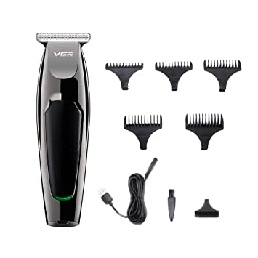
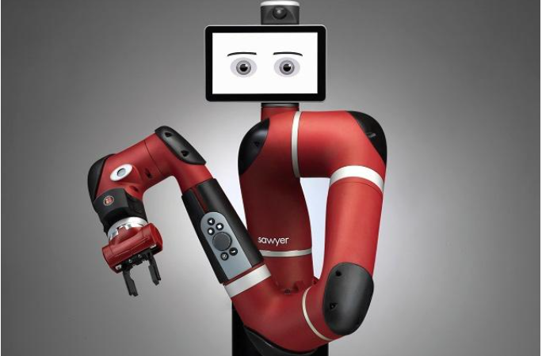
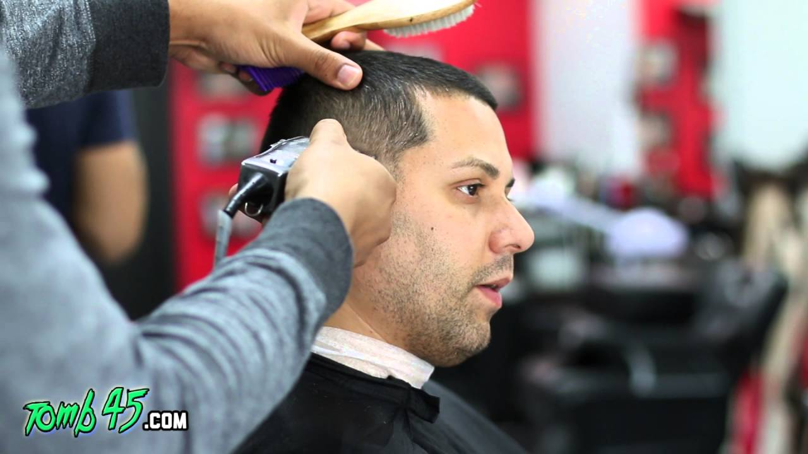
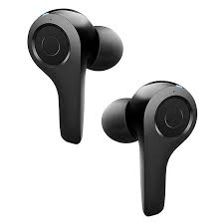
Proof of Concept
→ →

Slide 2
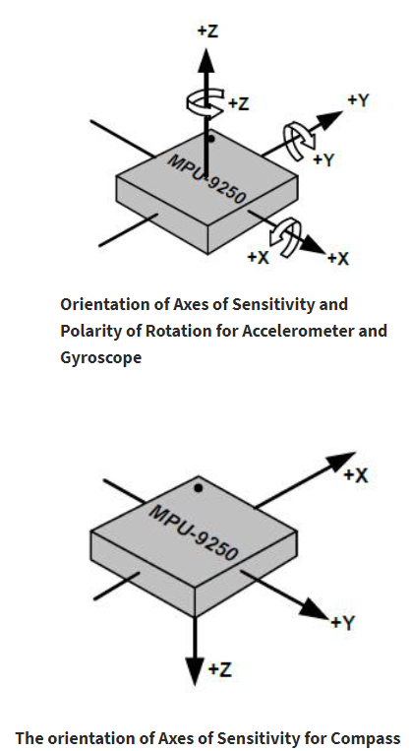
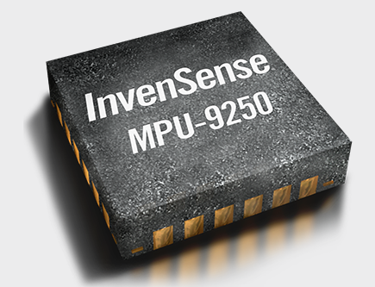
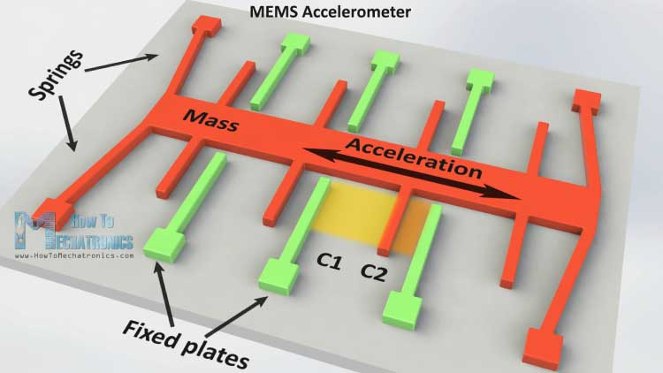
Motion Tracking
Precise motion tracking using an accelerometer and gyroscope
Develop a motion tracking module limited to 1 orientation, and 1 dimension
Motion tracker used: MPU-9250 ,MEMS
MEMS - Microelectromechanical systems

Slide 3
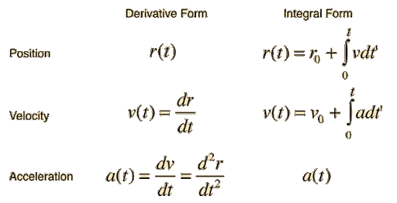
Acceleration to Position

Slide 4
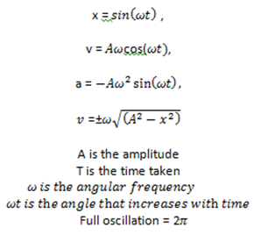
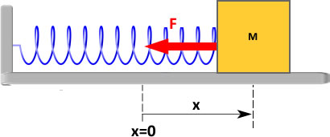
SHM - Test Case, 1 Dimension

Slide 5
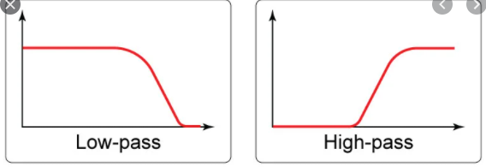
Noise and Drift velocity
To reduce noise and the acceleration data, we use a low pass filter
To reduce drift velocity/position, we use a high pass filter

Slide 6
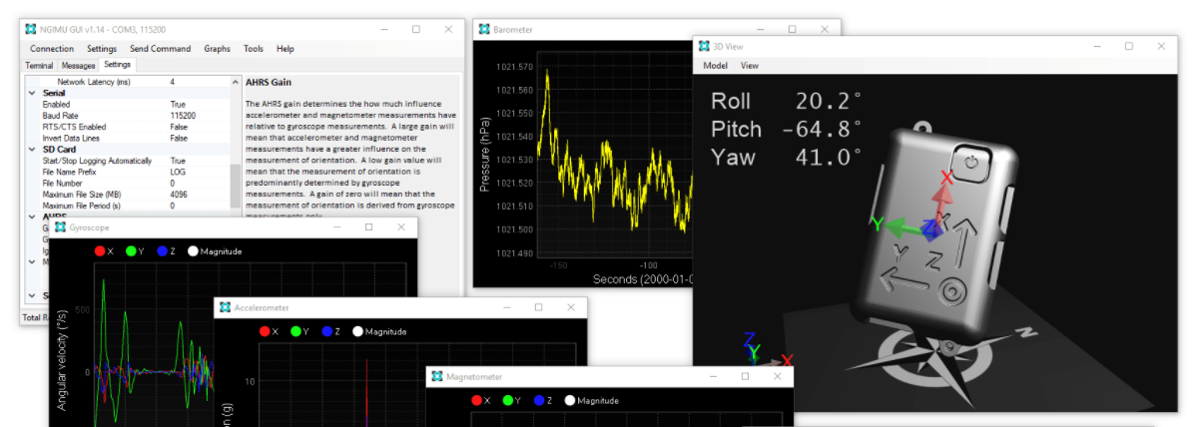
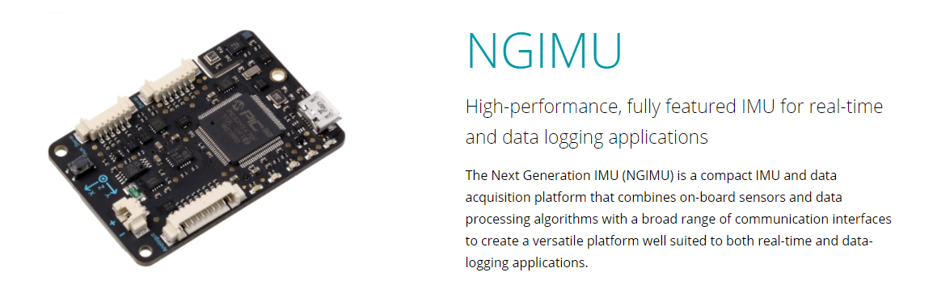
MPU-9250 Price ~ $10 CAD
Best choice in terms of price, precision, and size.
~300 Hz, 14 bit resolution, +\- 60mg/s^2 = 0.58m/s^2
Other options:
NGIMU ~ $500 CAD
x-IMU

Slide 7
Conclusion

Slide 8
Test Plan
Tracking Module
Quantitative
Define an error function using object tracking contained in the OpenCV3 library
Full product test
Qualitative
Implement using an robotic arm, and model hair/heads.
Test cases
General
20-30 minutes long
Cover space of a normal haircut

